Slide 1
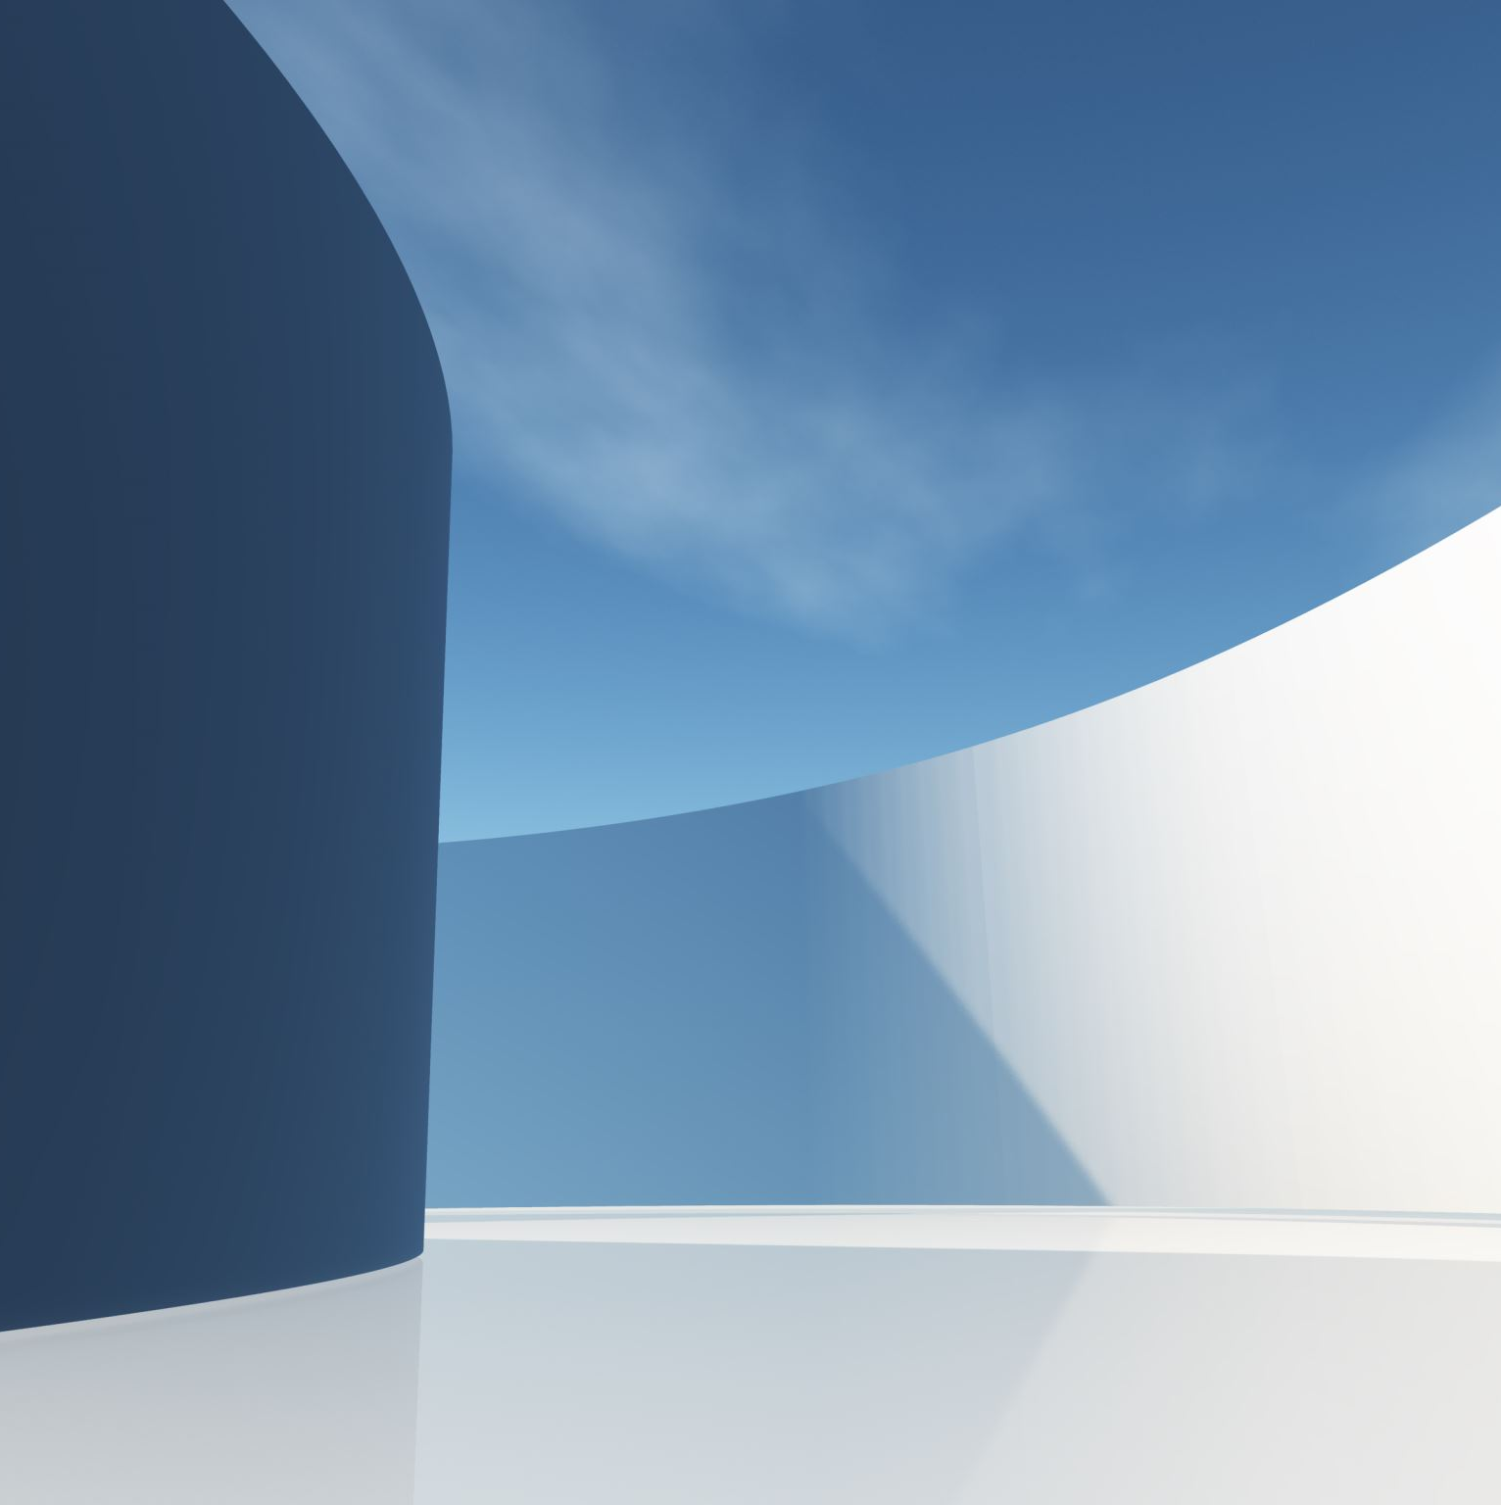
Autonomous Agent
MULTI-AGENT
YERIM MOHAMED 21052002

Slide 2

ACTIVITY 1
BASIC MODE

Slide 3

BASIC MODE
Objectives
Exploring and movement around the farm according to each type of robot capabilities.
Drones locate crops to be collected and wait for the picker robots, once they get there, the drones continue exploring
Amphibious picker robots move randomly to locate the crops to be collected, pick the crops until their storage is full,
In that case they return to the base station to unload the crops collected and continue picking.
Robots have a battery whose energy is consumed as time progresses

Slide 4
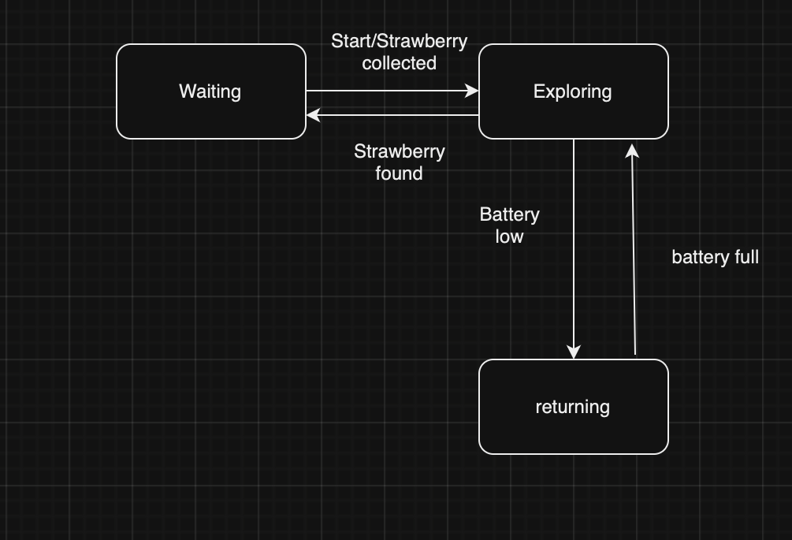
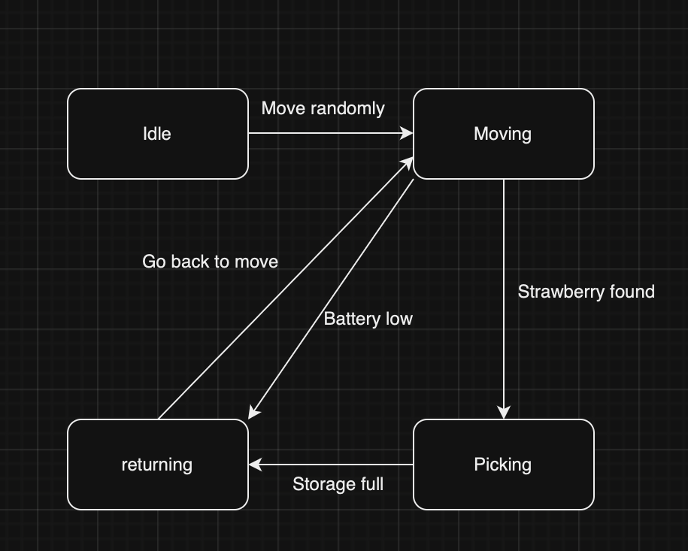
Statechart of the agents
Drones
Picker

Slide 5
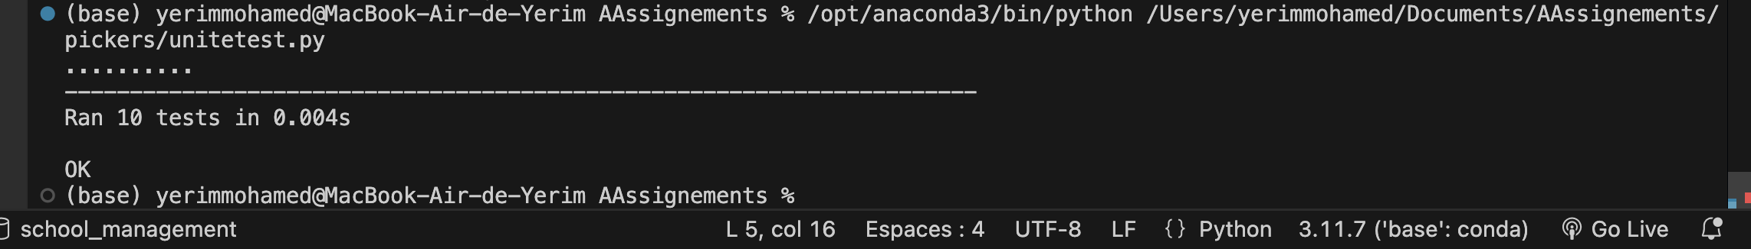
Unittest

Slide 6

Activity 2
z

Slide 7

Farm simulation game
Objective: The Farm Simulation Game aims to model the operations of an autonomous farming system using drones and picker robots.
Agents:
Drones: Autonomous agents that explore the farm
Environment:
Grid: A 2D grid representing the farm, with cells containing strawberry clusters, trees, rivers, and a base station.
Strawberry Clusters: Grow and regrow over time, can be picked by picker robots.
Base Station: Central location where drones and picker robots return to recharge and unload strawberries.
Gameplay:
Drones explore the grid to find strawberry clusters.
Picker robots move to the locations identified by drones to pick strawberries.
Both drones and picker robots return to the base station when their battery is low or their storage is full.
Picker Robots: Autonomous agents that move randomly

Slide 8
Game Analyse
Autonomous Agents:
Drones: Explore the grid, identify strawberry clusters, and communicate their locations to picker robots.
Picker Robots: Move to the identified locations, pick strawberries, and return to the base station.
State Transitions:
Drones: Waiting, Exploring, Returning.
Picker Robots: Idle, Moving, Picking, Returning.
Environment Interaction:
Grid Navigation: Agents move within a 2D grid.
Resource Management: Agents manage battery levels and storage capacities.
Communication:
Drones broadcast the location of strawberry clusters to picker robots.
Regrowth Mechanism:
Strawberry clusters regrow after being picked, simulating real-world farming conditions.

Slide 9
Decision Making:
Agents make decisions based on their current state, battery level, and storage capacity.
Efficiency:
The game aims to optimize the efficiency of strawberry picking by coordinating the actions of drones and picker robots.
Scalability:
The game can be scaled by adjusting the number of drones and picker robots.
Realism:
The game incorporates real-world constraints such as battery life, storage capacity, and regrowth time for strawberries.

Slide 10
Reflection
Usefulness:
The game can be useful in practical farming scenarios by providing a simulation environment to test and optimize the deployment of autonomous drones and picker robots.
It can help farmers understand the efficiency and limitations of using autonomous agents for farming tasks.
Fit with Scenario:
Autonomous Agents: The use of drones and picker robots fits well with modern farming practices that aim to automate tasks and increase efficiency.
Resource Management: The game's focus on battery and storage management aligns with real-world constraints in farming.
Communication: The broadcasting mechanism for locating strawberry clusters simulates real-world communication between autonomous agents.
Potential Issues:
Realism: The game may oversimplify certain aspects of farming, such as the regrowth mechanism and the behavior of strawberry clusters.
Scalability: The game's scalability may be limited by computational resources, especially when simulating large farms with many agents.
Environmental Factors: The game does not account for environmental factors such as weather, pests, and soil conditions, which can significantly impact farming operations.

Slide 11
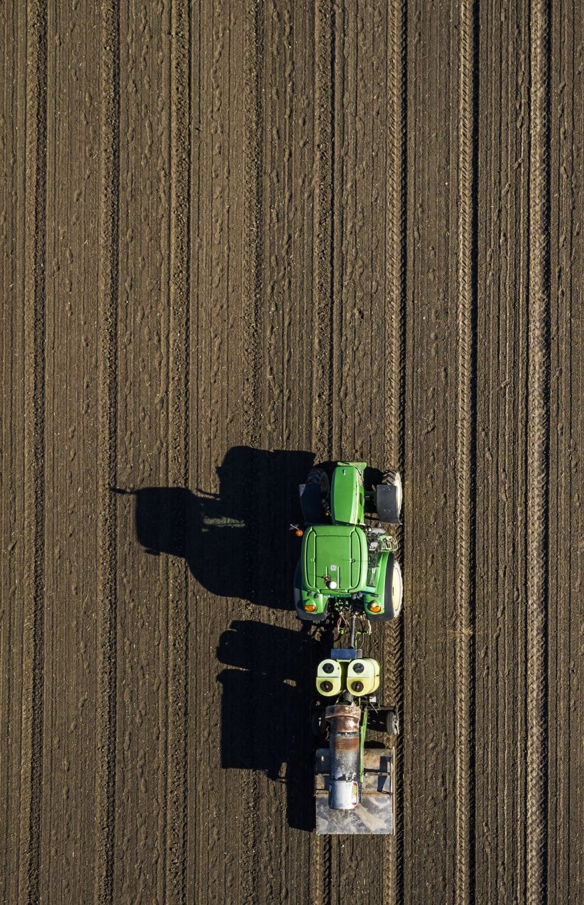
References
Reference list
James and Wainwright, J. (2018a). Agent-Based Modelling and Landscape Change. MDPI.
James and Wainwright, J. (2018b). Agent-Based Modelling and Landscape Change. MDPI.
Müller, J.P., Wolf Ketter, Gal Kaminka, Gerd Wagner and Nils Bulling (2015). Multiagent System Technologies. [online] Cham Springer International Publishing Imprint: Springer. Available at: https://web.cs.umass.edu/publication/docs/2003/UM-CS-2003-012.pdf [Accessed 13 Dec. 2024].

Slide 12

Activity 3
Extended Operation
  Communication of drone and picker robots to avoid random movement of picker robots: picker robots only leave the station once the drone send a signal with coordinates of where the crops need to be collected. Drone can send messages to individual robots or broadcast location of the crops to all the robots.
  Crops age and grow as simulation progresses. Once an area has been fully picked new seeds are grown, re-starting the ageing cycle. Environment handles the ageing and re-growing of strawberries.

Slide 13
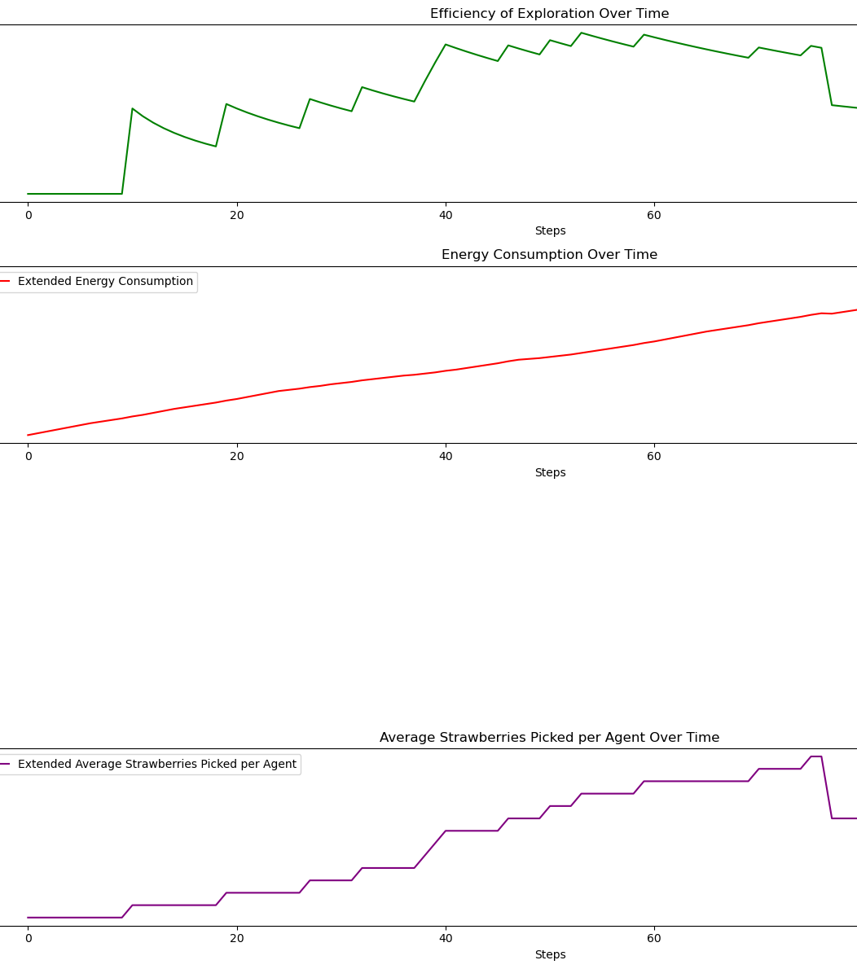
KPIS plot
Critical Analysis: Extended Model: 1. Total Strawberries Picked: 5.00 2. Total Energy Consumed: 406.00 4. Average Strawberries Picked per Agent: 1.6
Efficiency of Exploration: Measures the ability to locate strawberries effectively over time.
Energy Consumption: Evaluates the energy usage efficiency of the drones and picker robots. 7. Average Battery Level: Monitors the overall energy status of the agents over time.
Average Strawberries Picked per Agent: Measures the average number of strawberries picked by each picker robot.

Slide 14
Activity 4
Objective: Introduce a novel feature that leverages multi-agent system concepts to improve farm automation.
Feature Description: Implementation of a pattern followed by drones that allow each drone to take a horizontal and vertical direction to explore the grid column by column. Once crops found send signal to the closet robot.
Goals:
Increased efficiency in crop collection
Optimized energy consumption
Enhanced overall system performance

Slide 15
Comparison of novel and extended mode
Structural Elements
- Agents: Drones and Amphibious Picker Robots
-Environment: A crop farm with tree and river
Communication: Interaction between drones and picker robots
Coordination Mechanism: Central unit for task allocation and charging
Dynamics (Behavior):
Drones Explore the farm randomly or follow a pattern (Novel model).
Inform the closest picker robot of crop locations (Novel model).
Wait for picker robots to arrive.
Amphibious Picker Robots:Receive crop location data from drones.
- Move to and harvest designated crops until storage is full.
Return to base to unload and recharge.
Central Coordination Unit:
Receives crop data from drones.
Allocates tasks based on robot proximity and availability (Novel model).
Monitors energy levels and manages recharging schedules.

Slide 16
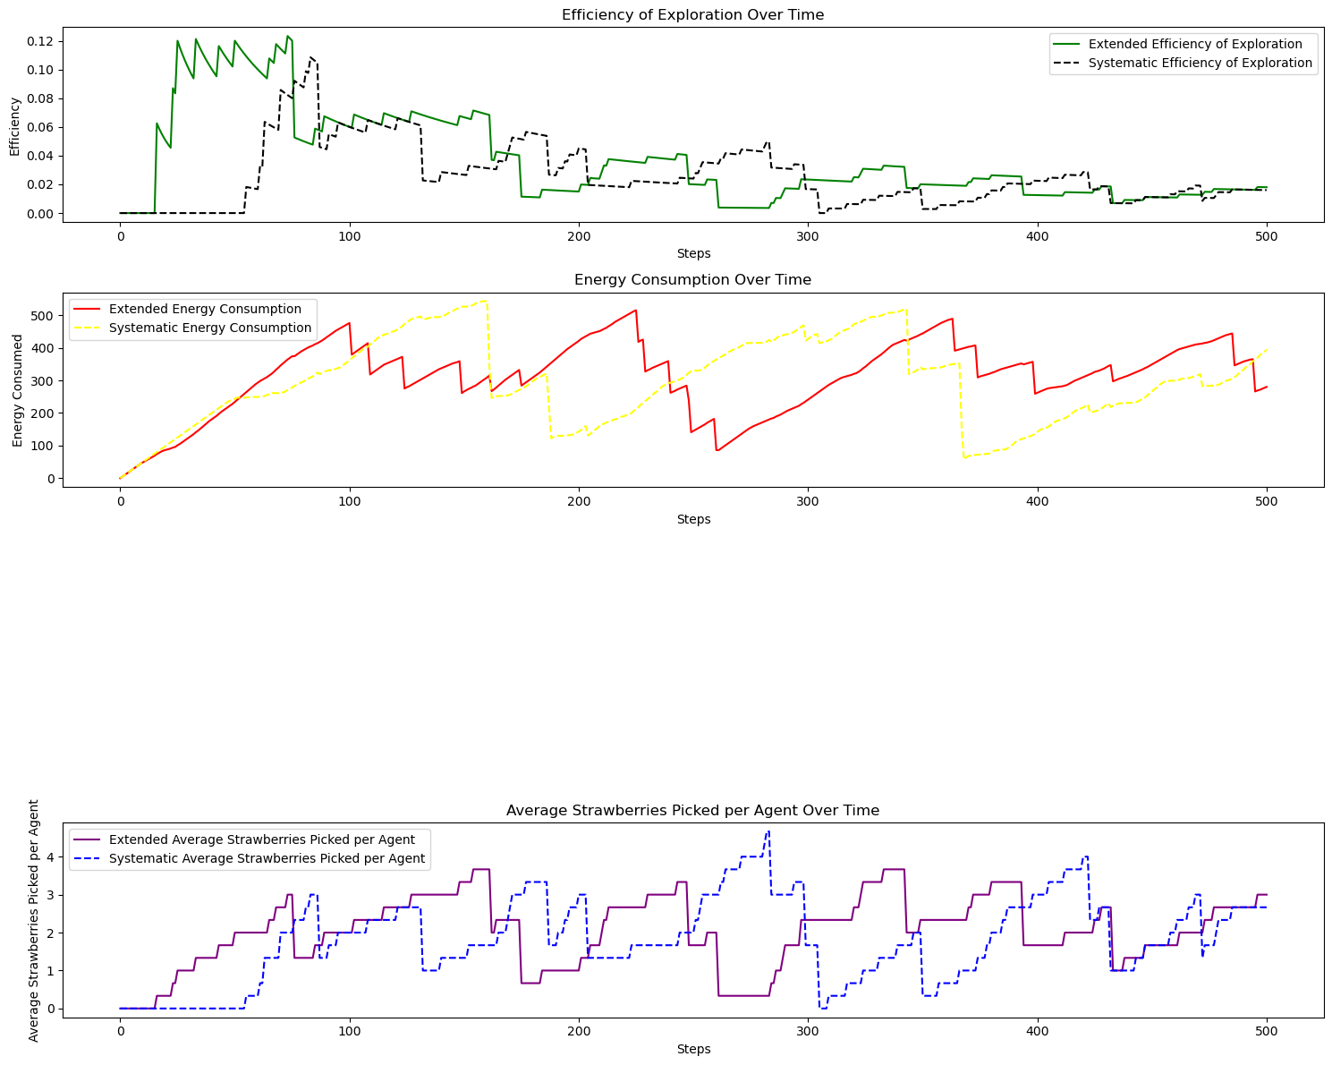
Graph
Critical Analysis: Extended Model: 1. Total Strawberries Picked: 9.00 2. Total Energy Consumed: 280.00 4. Average Strawberries Picked per Agent: 3.00 Systematic Model: 1. Total Strawberries Picked: 8.00 2. Total Energy Consumed: 395.00 4. Average Strawberries Picked per Agent: 2.67 Comparison: 5. Efficiency of Exploration: My novel mode is not more efficient than the extended mode. Energy Consumption: mostly equal Average Battery Level: mostly equal. Average Strawberries Picked per Agent: mostly equal.

Slide 17

Thank you for listening
z

